Slide 2
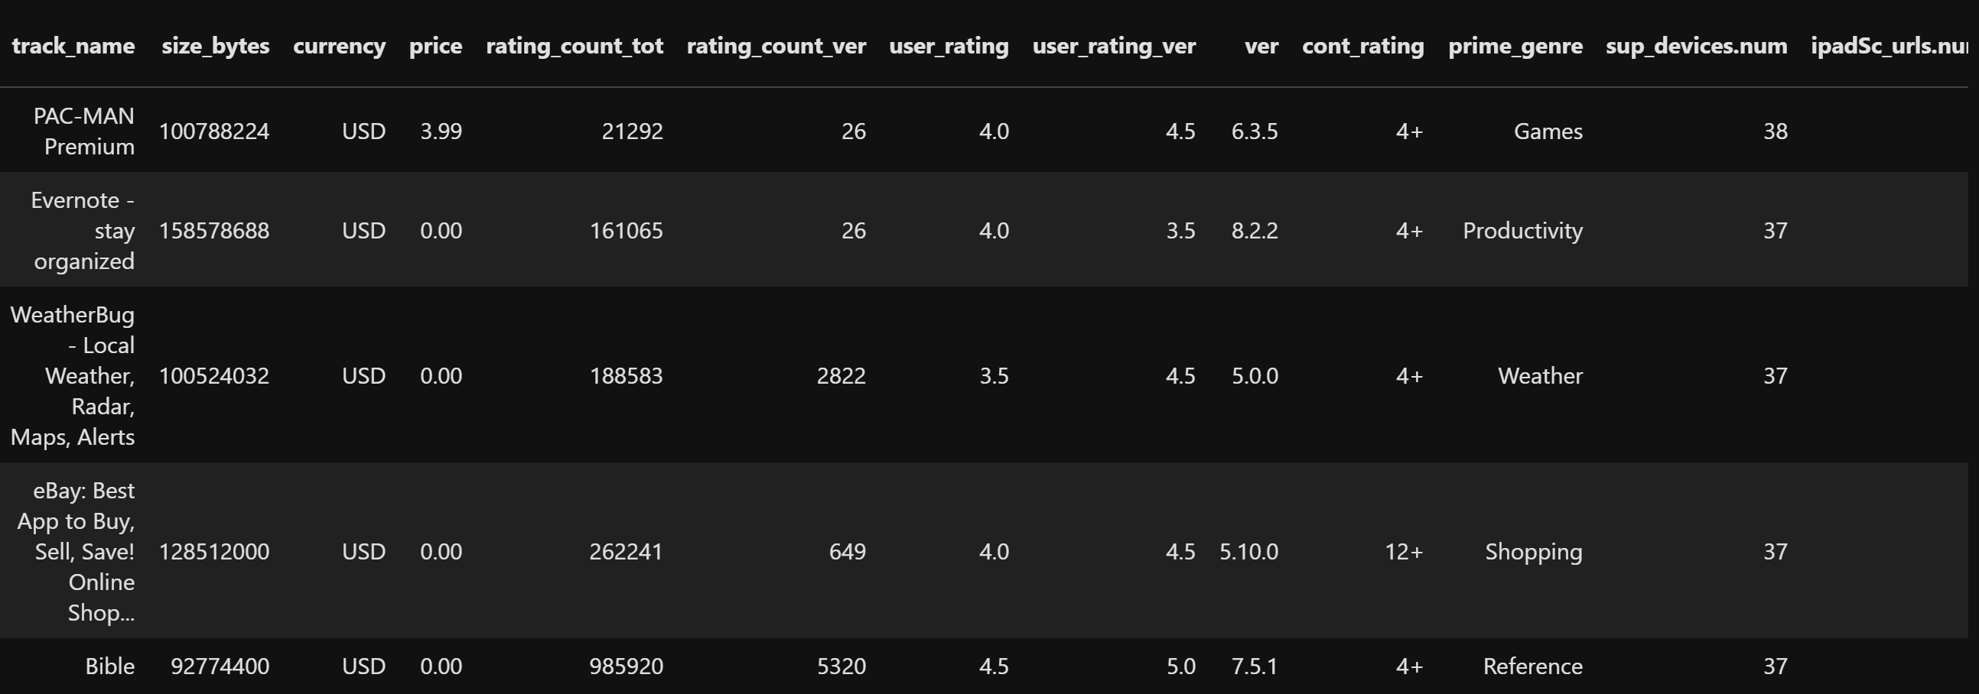
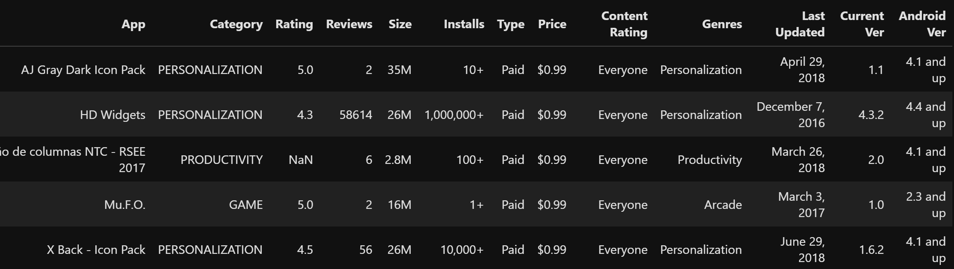
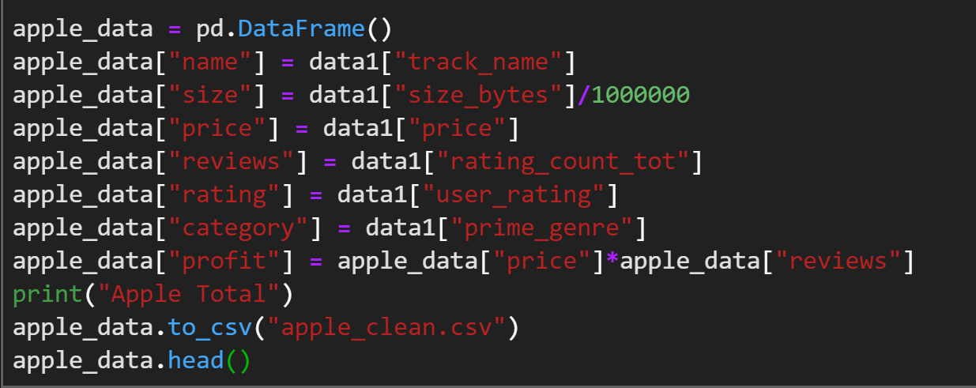
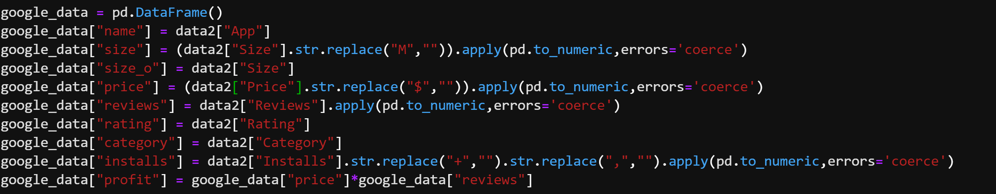
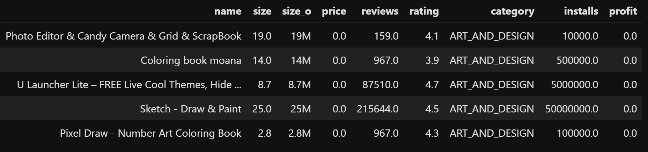
Cleaning Data
Apple
Google

Slide 3
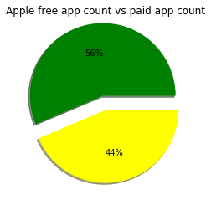
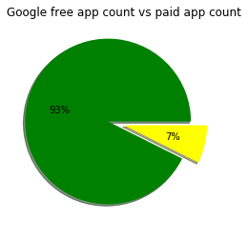
Significant difference between two data,
Why? Maybe because apple users are more likely to spend money on apps? Proof of iphone price? stricter process to upload apps?
Because of significance lead us to combine two datasets to account to look from more general perspective

Slide 4
Merged Data
After extracting apps that exist in both markets, ended up with 328 applications.
There were some difference in app information(some free in Apple but cost money on Google, etc)
Averaged numbered data to look at general trend.

